Slide 1
BELLS
Accounting
Assistant
Agent
AgentX Platform | Anthropic Claude 4.5 Haiku | RAG
Presented by Sylvester Ang Soon Rong | Cohort 1
SCTP Agentic AI Course

Slide 2

Accounting
Assistant
Agent
An AI-powered Accounting Assistant Agent built on AgentX, automating financial document analysis and assisting users with accounting tasks using uploaded knowledge documents.
The Agent will be able to:
• Extract financial info from uploaded files
• Retrieve accounting knowledge using RAG
• Generate structured financial outputs
• Assist users via live AI chat
• Improve accounting workflow efficiency

Slide 3
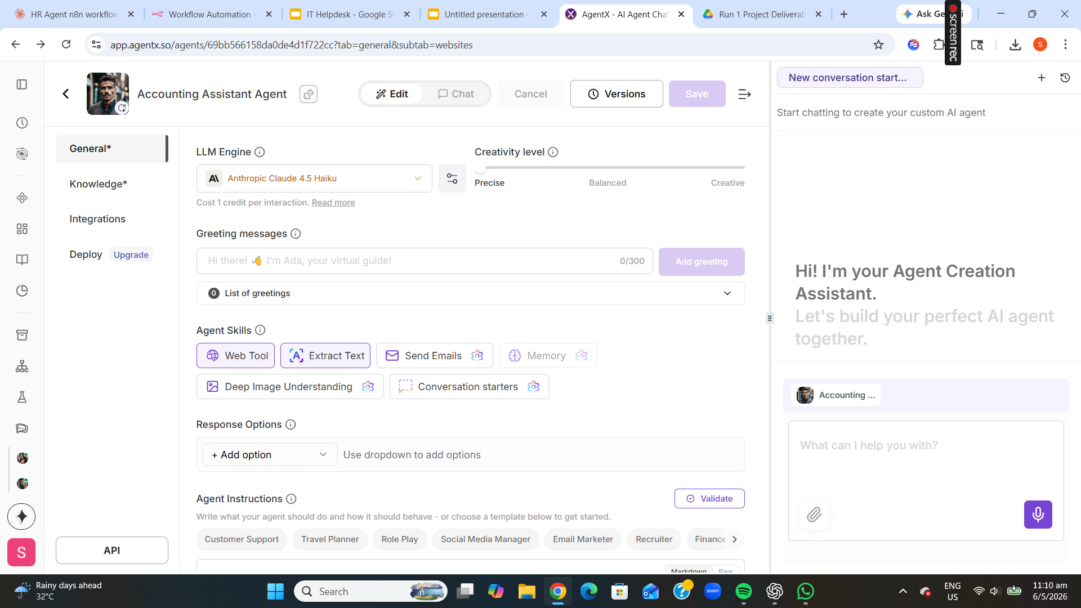
Sample
Workflow
• Anthropic Claude 4.5 Haiku LLM
• Web Tool + Extract Text enabled
• Creativity level: Precise
• AI-powered accounting workflow
• Deployed on AgentX platform

Slide 4
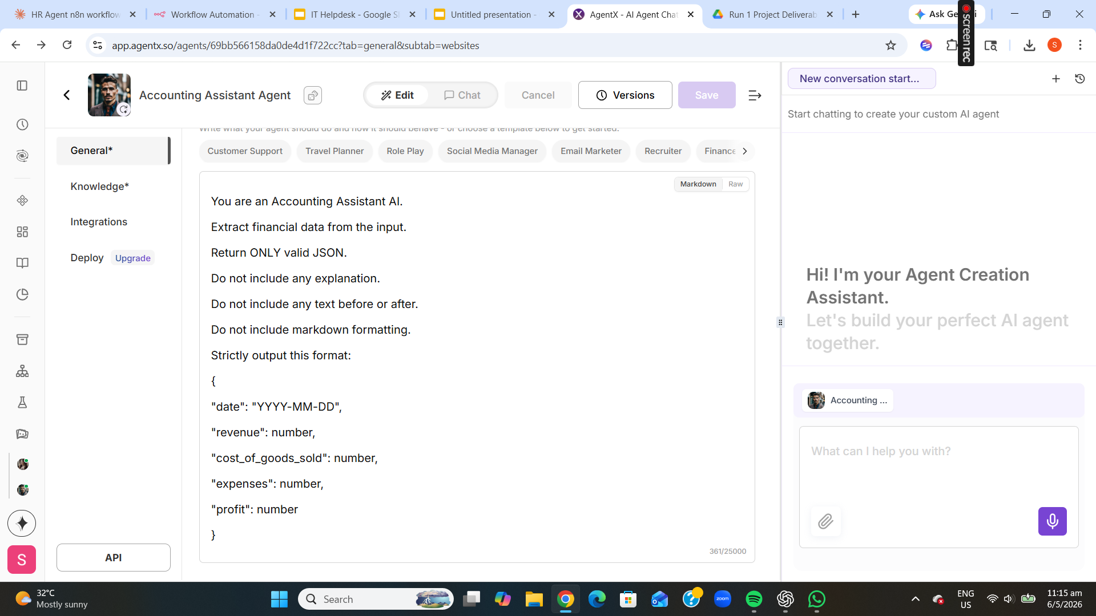
Sample
Agent
Instructions
• Strict JSON output format
• Financial data extraction rules
• No markdown, no explanation
• Response validation constraints
• Structured system instructions

Slide 5
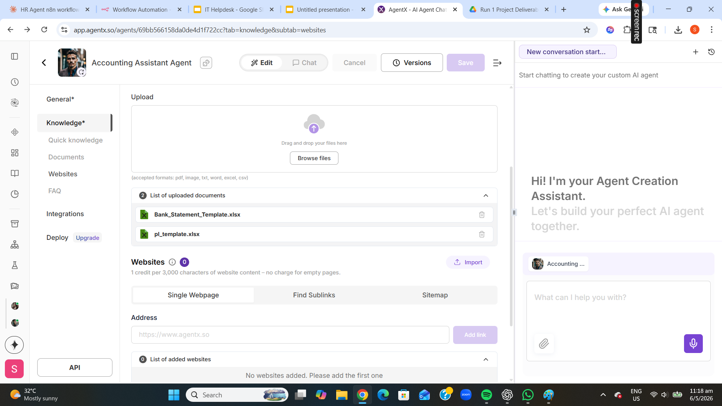
Sample
Knowledge
Base
• Bank_Statement_Template.xlsx
• pl_template.xlsx uploaded
• RAG retrieves relevant context
• Reduces hallucination
• Improves response accuracy

Slide 6
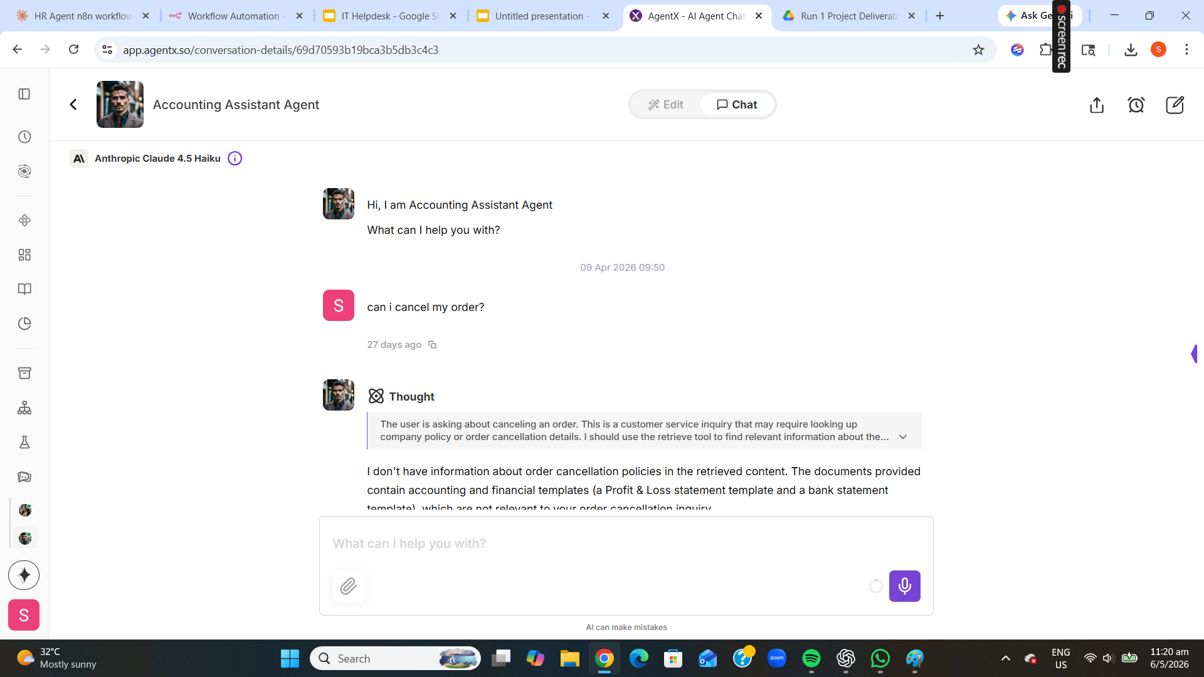
Sample
Live Chat
Interaction
• User submits accounting query
• AI Thought process shown
• Queries knowledge base (RAG)
• Context-aware response generated
• Powered by Claude 4.5 Haiku

Slide 7
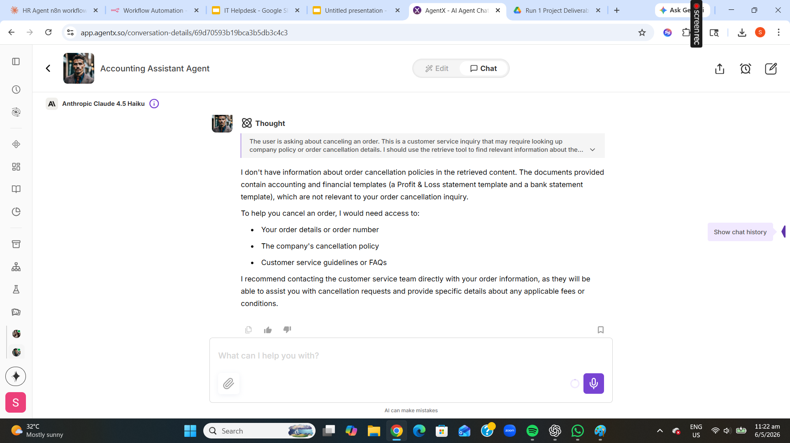
Sample
Output
• AI retrieves knowledge references
• Structured contextual response
• References uploaded templates
• Honest when outside scope
• Recommends next steps clearly

Slide 8
Technologies
Used
AgentX Platform
Claude 4.5 Haiku
RAG Knowledge Retrieval
Cloud-based AI agent builder for rapid no-code deployment
Anthropic LLM — precise, cost-efficient AI responses
Document-grounded answers from uploaded financial files
Prompt Engineering
Financial Doc Processing
AI Chat Interface
Strict JSON output enforced via system instructions
Bank statements & P&L templates as the knowledge base
Live chat for real-time user interaction and queries

Slide 9
Thank
You
Conclusion
• Successfully built Accounting Assistant Agent on AgentX
• RAG-based knowledge retrieval from financial documents
• Live AI financial assistance using Claude 4.5 Haiku
• Enhanced accounting workflow automation and accuracy
Sylvester Ang Soon Rong · Cohort 1 · SCTP Agentic AI Course

